Slide 1
James 2:14-26
13because judgment without mercy will be shown to anyone who has not been merciful. Mercy triumphs over judgment! 14What good is it, my brothers, if a man claims to have faith but has no deeds? Can such faith save him? 15Suppose a brother or sister is without clothes and daily food. 16If one of you says to him, "Go, I wish you well; keep warm and well fed," but does nothing about his physical needs, what good is it? 17In the same way, faith by itself, if it is not accompanied by action, is dead. 18But someone will say, "You have faith; I have deeds."

Slide 2
James 2:14-26
19Show me your faith without deeds, and I will show you my faith by what I do. You believe that there is one God. Good! Even the demons believe that-- and shudder. 20You foolish man, do you want evidence that faith without deeds is useless ? 21Was not our ancestor Abraham considered righteous for what he did when he offered his son Isaac on the altar? 22You see that his faith and his actions were working together, and his faith was made complete by what he did.

Slide 3
James 2:14-26
23And the scripture was fulfilled that says, "Abraham believed God, and it was credited to him as righteousness," and he was called God's friend. 24You see that a person is justified by what he does and not by faith alone. 25In the same way, was not even Rahab the prostitute considered righteous for what she did when she gave lodging to the spies and sent them off in a different direction? 26As the body without the spirit is dead, so faith without deeds is dead.

Slide 4
pearls from James
James 2:14-26
Faith-filled Christians are compelled to act in response to the mercy and love that we have received from Jesus.
Our deeds as Christians are not fulfilling any law. Our actions are fulfilling God’s purpose for us and the world.
Notes:
In these verses James is differentiating between ‘believers’ and ‘disciples’.
Faith-filled Christians are compelled to act in response to the mercy and love that we have received from Jesus.
Our deeds as Christians are not fulfilling any law. Our actions are fulfilling God’s purpose for us and the world.
James says when we see someone needing food or clothing, we act with grace and mercy to fill the need.
I think it’s reasonable to expand this thought to:
When we see someone hurting from loss, we respond in grace and mercy. We stand with them. Pray for them.
When we sense that our mate is struggling with life, we take time to share the load.
In converse, If we see someone needing grace and mercy and do not act, we are diluting the substance of our faith.
(vs 20) You fool, When will you ever learn that faith that does not result in good deeds is useless?
We are not acting from a place of abundance. The abundant mercy and love we have received from Jesus.
This is James’ warning to the early Christians. This is James’ warning to us.
Vs 19 – Do you still think it’s enough just to believe that there is one God? Well, even the demons believe this, and they tremble in terror!
This is a daily challenge for me. I always appreciate Jesus as my Saviouir but I struggle to follow him as Lord as I should. I suspect it is for many of us.
So each day, we should pray:
Lord I want to engage with life and those around me today, showing mercy and love to others as you would have me.
I need your help and wisdom.
Thank you for prompting me and guiding me and maturing me.
Lord help me be a faith-filled Christian today.

Slide 5
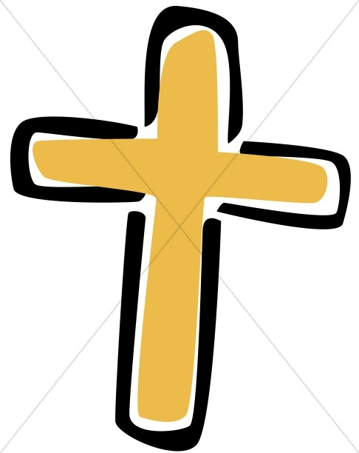
Pearls from James
James 2:14-26
Religious Christians – take out heaven insurance policy
Pay premiums in obligation
death = pay out ----- place in heaven
LIFE ON EARTH LIFE WITH JESUS ………….
No premiums, policy pays out upon acceptance / death = continue the eternal life
Faith-filled Christians – accept eternal life policy
Notes:
My way to look at what James is saying is by this graph.
1. Our lives can be represented by the white arrow – beginning with our birth and stretching to the right. At some point along our journey we come to believe in Jesus Christ (represented by the Cross) and from then on, stretching into eternity we have a life with Christ.
2. For Religious Christians, after they believe in Jesus, there are two parts to life. The first part is like paying premiums (with good deeds) on a heaven insurance policy. Upon death the insurance pays off and my good deeds will earn my entry into heaven.
This was what the old covenant had evolved into for many Jews.
As I keep the Law, I’m paying the premiums for God’s blessing in this life and my place in heaven. This was typified by the Pharisee in the temple who self-righteously compared himself to the tax-collector. “Lord thank you that I’m not like him. I keep the Law, so you love me more and will bless me.”
It was James, Peter and Paul that had to flip this kind of thinking about what God required. Today, we can also fall into trying to earn our place in heaven by being good and acting out of obligation. We can be deceived in thinking that our time on earth is an obligation to ourselves, to insure we are paid up on our heaven insurance so when we die we can be with God. Religious Christians miss out on an earthly life with the constant and consistent interaction with God at our side each day.
[animate]
3. Faith-filled Christians – accept Jesus as Saviour and Lord. Accepting Jesus as Lord, means our eternal life begins when we believe in Jesus! We don’t wait till heaven to begin relationship with God. We begin immediately, once we accept Jesus, to trust and commit to a life with God available to us, at our side every step everyday. In response to what Jesus has done for us, we lay down our desires for God’s desires for us. We follow the promptings of the Holy Spirit. We are disciples.
This only means that we are always thinking, ‘God, lead me today, I have my agenda but direct me in what I do today to include what you would have me do, as well.
NEXT SLIDE - Abraham and Rahab

Slide 6
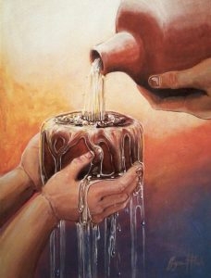
Pearls from James
James 2:14-26
Abraham (v 22) You see, he was trusting God so much that he was willing to do whatever God told him to do. His faith was made complete by what he did - by his actions.
Rahab (v 25) was made right with God by her actions – when she hid those messengers and sent them safely away by a different road.
Your story (John 21:15) Do you love Jesus? Then feed his lambs. How is the mercy I’ve received flowing over to others?
Notes:
James puts forward Abraham and Rahab as examples to follow.
Abraham (read slide point)
In offering Isaac, Abraham trusted God and tested his faith in God. When we trust our faith enough to step out on the unsure waters before us, we are made complete.
Rahab (read)
Rahab was a Gentile, unfamiliar with any protocol for honouring God- Her acknowledgement of God was through her words, ‘For the Lord your God is the supreme God of the heavens above and the earth below’. Joshua 2
Then she acted by aiding the spies. By her words and actions she proved she was a true believer.
I think of Jesus being my Saviour and Lord as this depiction here.
I offer my cup as a symbol of my life. Jesus thank you for your action of sacrifice, that is all that I need to be in right relationship with God. I now realise that you offer me this living water and I want to drink from it from this day and forever. Fill my cup with your mercy and love. I accept you as my Saviour.
Then Jesus gladly fills my cup and this love and mercy is so dynamic and abundant, it overflows, so that I have more than enough for me and an overflow to share. So I look for opportunities to offer his mercy and love on others.
What is your story? Do you love Jesus? Are you filled with the knowledge of what Jesus has done for you? Are you filled to overflowing?
We follow in the steps of Peter, in whom Jesus placed his trust and confidence to carry on his purpose for coming to earth.
Jesus asked Peter 3 times, ‘Do you love me?” Peter affirmed his love for Jesus (3 times) saying, ‘You know I love you, Lord.”
Then, what did he tell Peter to do? “Feed my lambs. Take card of my sheep. Follow me.”
Peter, believed that Jesus died and was resurrected so Peter could have life abundantly, eternal life. Peter accepted Jesus as Saviour. Peter would now embark with the days he had left, being led by his Lord.
Abraham, Rahab, Peter, the Samaritan woman at the well and all our heros of the the faith, had challenges in their days. James suggests their approach to life was;
Approach each day as an opportunity to serve and mature.
Look to God for wisdom.
Engage with others in love and mercy.

Slide 7
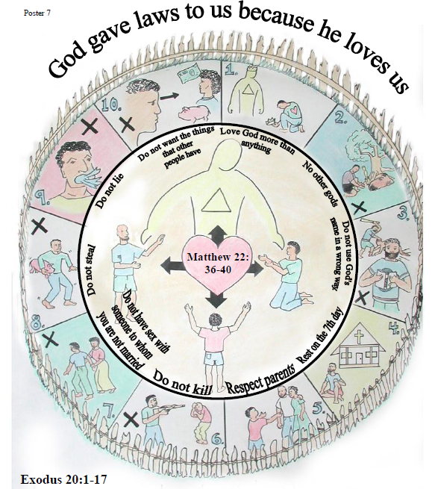
Proper view of God’s Law
James 2:14-26
3 parts of the poster
Fence
Inner circle with God in relationship with humanity
10 commandments
Notes:
This is just one lesson of 19 in the SALT discipleship course or Scripture Application and Leadership Training for churches in the Pacific. SALT uses Melanesian Culture to explain Biblical truths. Posters like this are printed LARGE, and can be taken into remote communities as Bible study aids. . This is what Wycliffe calls ‘Scripture Engagement’.
As you see there is not much text on this poster but mainly scripture references which is intentional for 1) simple to translate and 2) engages participants and their Bibles. So you just got your NT translated, now you can take the SALT discipleship course and begin to explore your new Bible that is in a language that you really understand and therefore can introduce you to Jesus in a deeply profound way.
There are three main parts of the diagram.
The Fence is an important part of rural village life in Melanesia. People put up fences to protect things that are of value.
In the middle of the fenced area is God and people. Matthew 22:36-40 is the key verse. Who knows what those verses say?
‘ Love the Lord your God with all your heart, soul and mind and love your neighbour as yourself ‘
There is nothing more important or of more value than humanities relationship with God
Just inside the fence are the 10 Commandments. The title to the poster is God gives us Laws because he loves us.
What do you think is the significance of the commandments being inside the protective fence? (protects our relationship with God and others)
This is the proper view of the purpose of the 10 Commandments.
The Pharisees of course made many more laws. And mistakenly placed the laws on the outside of the fence. The significance of that model is that we need to keep the law to get inside the fence, to be in relationship with God.
Belief in Jesus places us safely and securely within the fence and we are relationship with God without doing anything of our own action. With our relationship with God assured, we do all we can to keep from breaking through the fence. Our relationship with God is foremost of value and our relationship with our neighbours can flourish.
The Commandments help protect our relationship with God. God let Moses and the Israelites know what behaviour would protect relationships.
If we break one, only one, commandment we break through the fence. Our relationship with God and other is in jeopardy. broken. p with God and others.
So, we don’t keep the commands to so God will like us. We are already loved by God. Our deeds aren’t earning favour from God, our deeds are merely a way that we express our appreciation for what God has already done for us.
Our deeds as Christians are not fulfilling any law that rewards us. Our actions are fulfilling God’s purpose for us and the world.

Slide 8
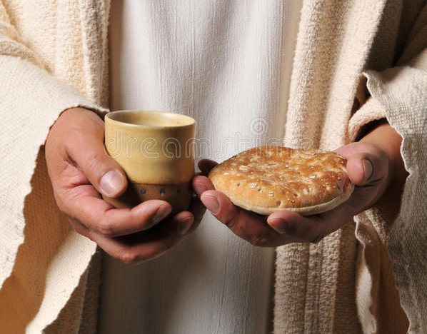
pearls from James
James 2:14-26
Disciples of Christ are compelled to act in response to the mercy and love that we have received from Jesus.
Our deeds as Disciples are not fulfilling any law. Our deeds are fulfilling God’s purpose for us and the world.
Notes:
Read first point-
Jesus displayed his mercy and love by sacrificing his body on the cross. The bread signifies his body, that was broken for us. As you eat the wafer, remember Jesus’ sacrifice has secured for you eternal life, with God now and forever. Eat and remember.
Read second point-
The juice signifies Jesus’ blood shed on the cross- the blood of the new covenant- that frees us from deeds to win God’s favour. Now we are free to join God in his plan for the world. Drink, the juice and remember Jesus is Lord of your life. Drink and remember.

